Slide 1





The Self-Sufficiency Standard for Oregon Annie Kucklick, Research Manager October 8, 2021 Work Systems
Notes:
Introduction
Agenda

Slide 2
Why the need for the Self-Sufficiency Standard?
The official poverty measure is outdated and not keeping up with the cost of living
A measure was needed that reflects actual costs of living
Notes:
A project of the Center for Women's Welfare (CWW), the Self-Sufficiency Standard is a budget-based, living wage measure that defines the real cost of living for working families at a minimally adequate level. The Standard is an affordability measure and an alternative to the official poverty measure.
The Self-Sufficiency Standard determines the amount of income required for working families to meet basic needs at a minimally adequate level, taking into account family composition, ages of children, and geographic differences in costs.

Slide 3
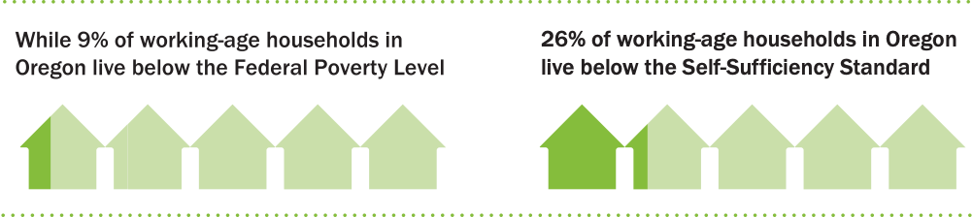
“If it is not possible to state unequivocally ‘how much is enough,’ it should be possible to assert with confidence how much, on an average is too little.” - Molly Orshansky, 1965
Notes:
Let’s talk about the official poverty measure.
Created by Molly Orshansky of the Social Security Administration in the early 1960s
A 1955 Department of Agriculture survey found that families generally spent about one third of their budgets on food
Thus, she calculated the poverty thresholds by pricing out the cost of food for a family and then multiplying the costs by three.
The food budget was calculated using the “economy food plan.” It’s the cheapest food plan and designed for temporary or emergency use
Ultimately, the only budget category with a specific dollar amount calculated is food.
In a 1965 article she presented the poverty thresholds as a measure of income inadequacy, not of income adequacy
“If it is not possible to state unequivocally 'how much is enough,' it should be possible to assert with confidence how much, on an average, is too little.”
Limitations of this approach to measuring poverty
Simply too low.
The methodology is frozen and doesn’t reflect real changes in family budgets
Food is no longer ⅓ of the budget--now typically around 12%
There is no variation by geographic location or family composition
The poverty measure is dated:
Implicitly uses a demographic model of a two-parent family with a “stay-at-home” wife
Paid employment is the norm, not the exception for the majority of parents today.
Resulting in:
9% of working age households being reported as living below the Federal poverty Level VERSUS 26% of working-age households in OR living below their means

Slide 4
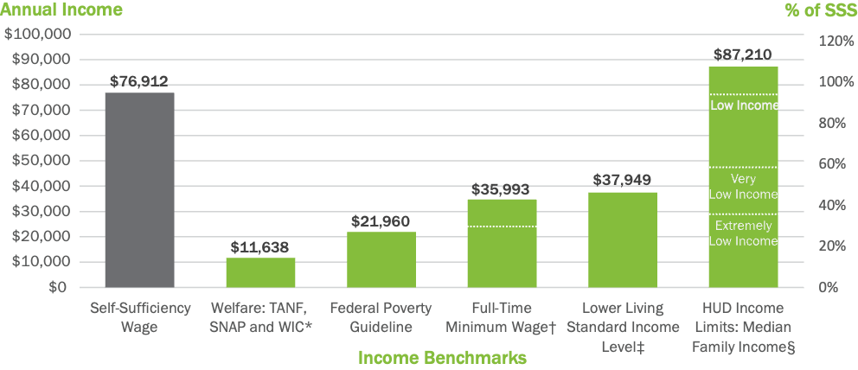
How much is enough?
The Self-Sufficiency Standard Compared to Other Benchmarks
Multnomah County, OR 2021: One Adult, One Preschooler, and One School-Age Child
Notes:
How much is enough?
So, if the poverty measure is a statistical yardstick that measures how much is not enough, how do we know how much is enough?
The Standard was developed to address the shortcoming of the official poverty measure.
First calculated in 1996 while Dr. Pearce was Director of the Women and Poverty Project at WOW
Initially designed as a performance measure for the goal of “self-sufficiency” in federal job training programs.
The task was to create a measure that was realistic and detailed on what clients needed to be self-sufficient
Early 2000s Dr. Pearce moved to UW and Ford Foundation provide funding major expansion
The Standard has been calculated for 41 states and has recently started receiving funding from IKEA for regularly updates in 27 states which Arizona is actually included in – which means that there is yearly updated data for Oregon

Slide 5








Data Components of the Self-Sufficiency Standard
Housing
Child Care
Health Care
Food
Taxes & Tax Credits
Emergency Savings
Miscellaneous
Transportation
Notes:
What is the Standard’s Approach?
The Standard takes a market basket approach of measure the cost of each basic need faced to working families.
Includes ALL major budget items faced by working adults, not just food: housing, child care, health care, transportation, taxes and tax credits, and miscellaneous costs.
Accounts for geographic differences in costs (very important for housing)
Varies costs by age groups of children (infants, preschoolers, school agers, and teenagers). This is especially important for child care, which varies substantially by age.
Reflects modern family practices: Assumes all adults work full-time and thus includes the employment related costs
Overall, the Standard defines a realistic measurement of the income requirements for over 700 different family types across each county in a given state.
Minimally Adequate
The Self-Sufficiency Standard defines the amount of income necessary to meet basic needs
No public assistance: public housing, food stamps, Medicaid or child care
No private/informal assistance: free babysitting by a relative or friend, food provided by churches or local food banks, or shared housing.
Very bare bones

Slide 6
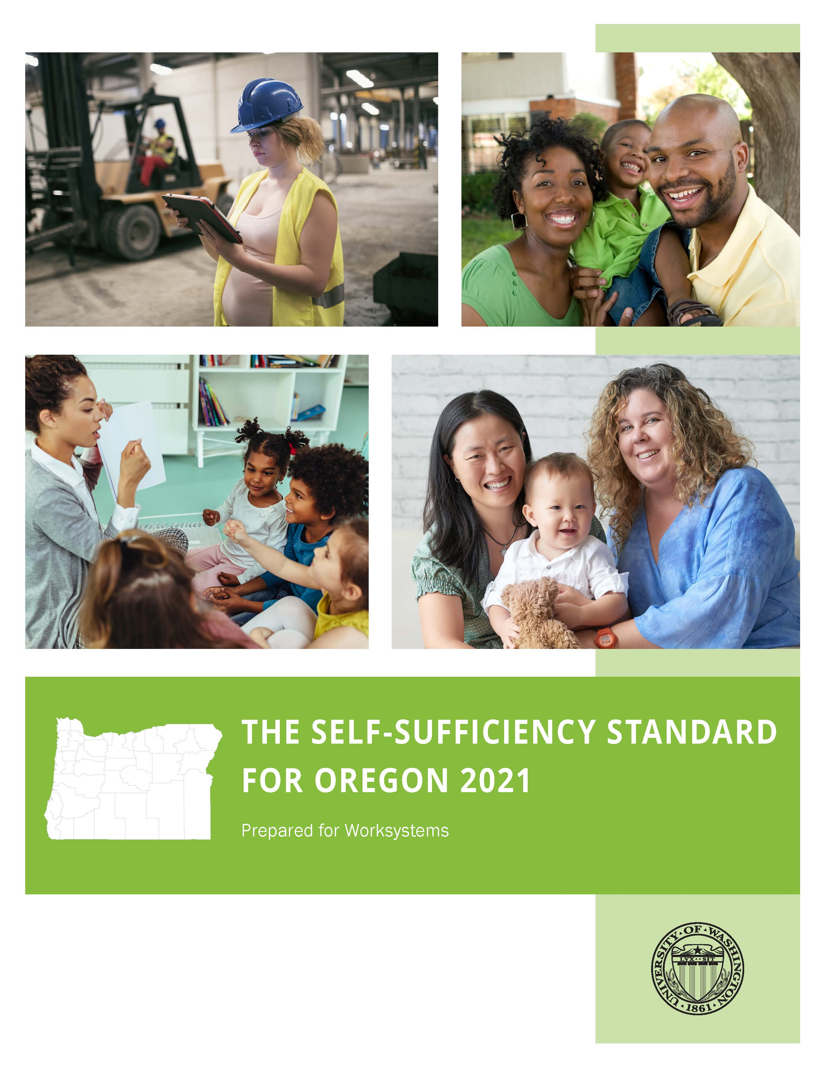
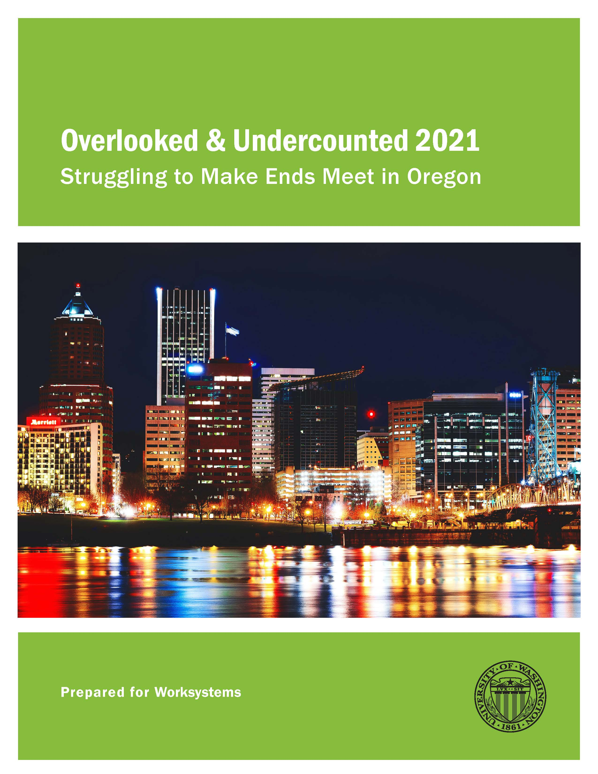
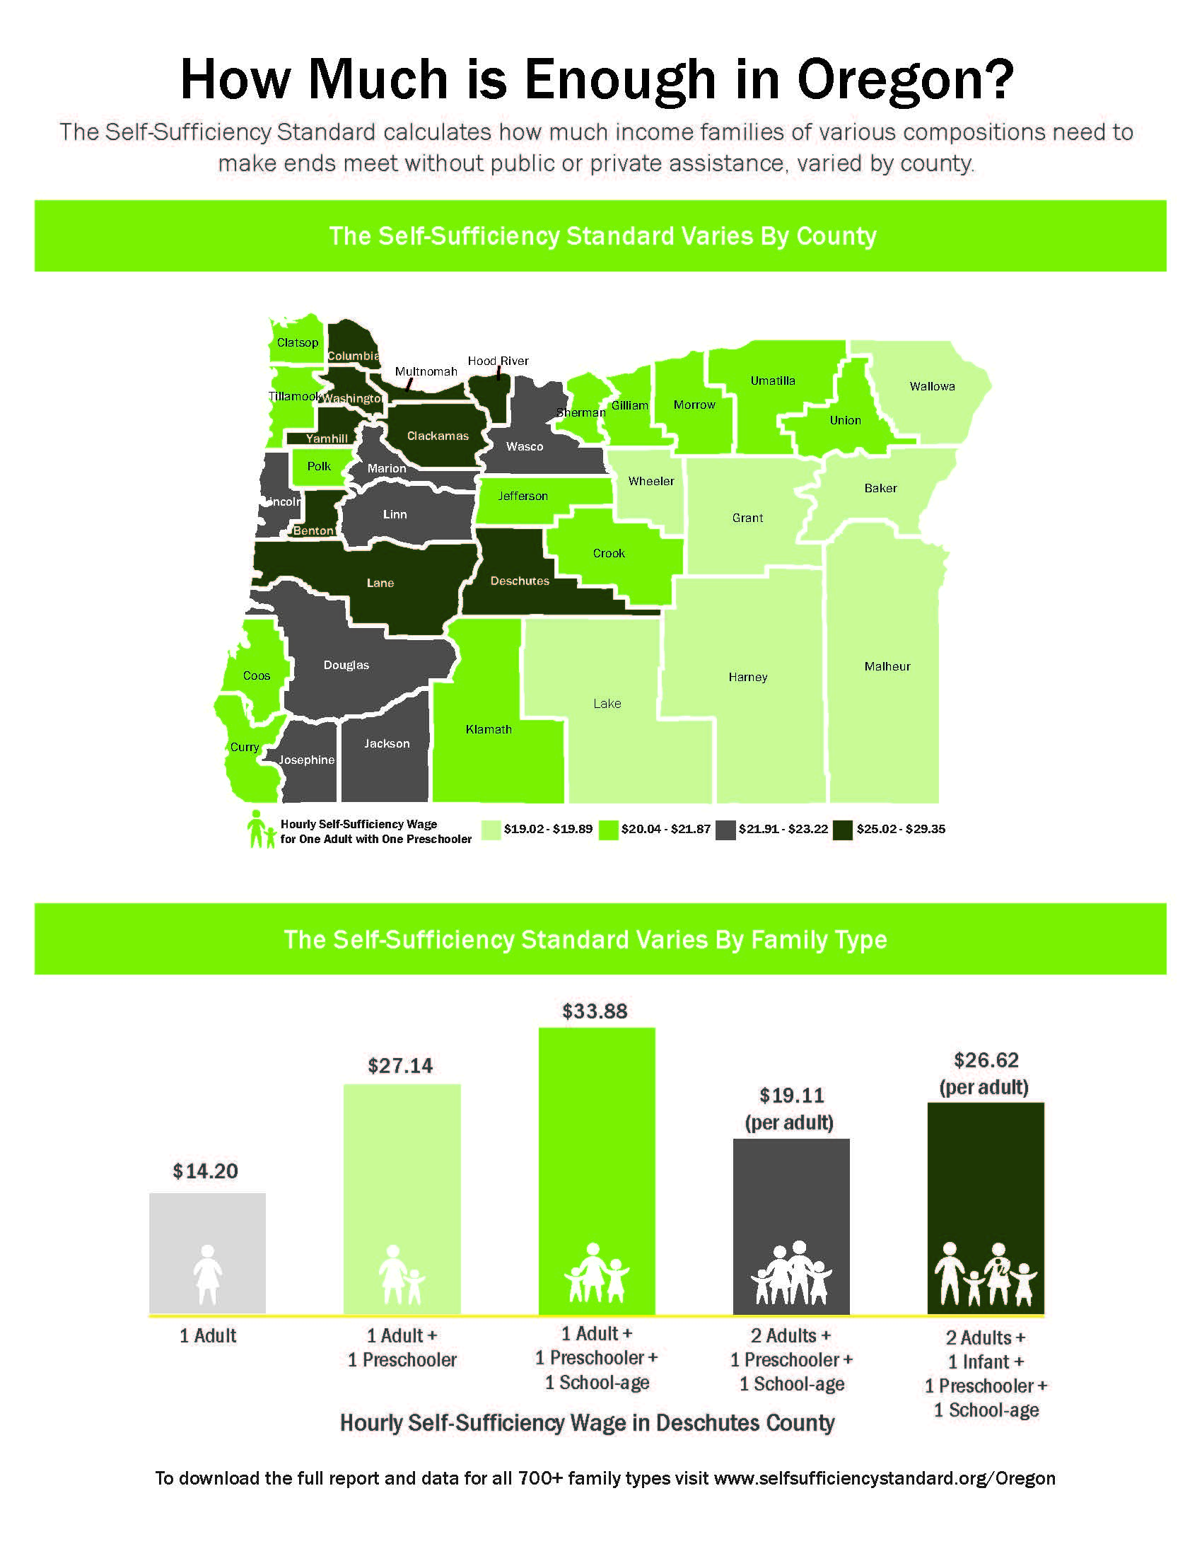
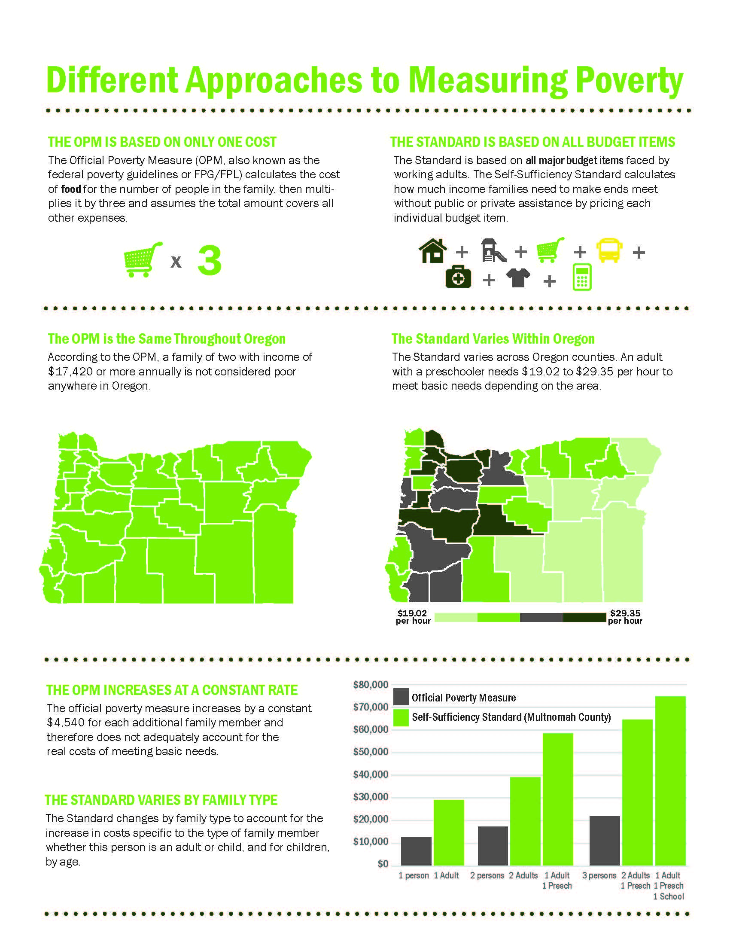
2021 Report Deliverables
Notes:
In partnership with WorkSystems and The Oregon Workforce Talent and Development Board (WTDB), the Center for Women’s Welfare, produced two separate reports, the first Self-Sufficiency Standard for Oregon 2021: begins by putting the Self-Sufficiency Standard in context, describing how it is a unique and important measure of income adequacy, and comparing and contrasting it with official poverty measures. The report then describes what a self-sufficient wage is for Oregon families and how it differs depending on family type and geographic area. The report compares Oregon to other places in the United States, examines how costs have increased over time, and contrasts the Oregon Standard to other commonly used benchmarks of income. For families without adequate income, the report models how public supports, such as child care assistance, can be a valuable resource to help families cover their basic needs as they move toward self-sufficiency. It concludes with a brief discussion of the various pathways to economic self-sufficiency and a sampling of the various ways the Standard is used.
The Overlooked & Undercounted 2021: Struggling to Make Ends meet in Oregon
describing which families are struggling to make ends meet—the families most at risk at being left behind in an uneven economic recovery. The Standard measures how much income is needed to meet families’ basic needs at a minimally adequate level, including the essential costs of working, but without any public or private assistance. Once these costs are calculated, we then apply the Standard to determine how many—and which—households lack enough to cover the basics. Unlike the federal poverty measure, the Standard is varied both geographically and by family composition, reflecting the higher costs facing some families (especially child care for families with young children) and the geographic diversity of costs across Oregon.

Slide 7
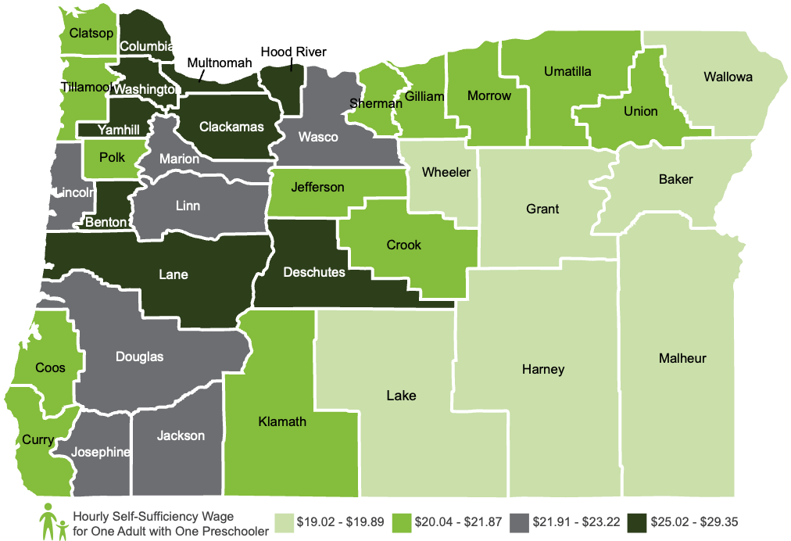
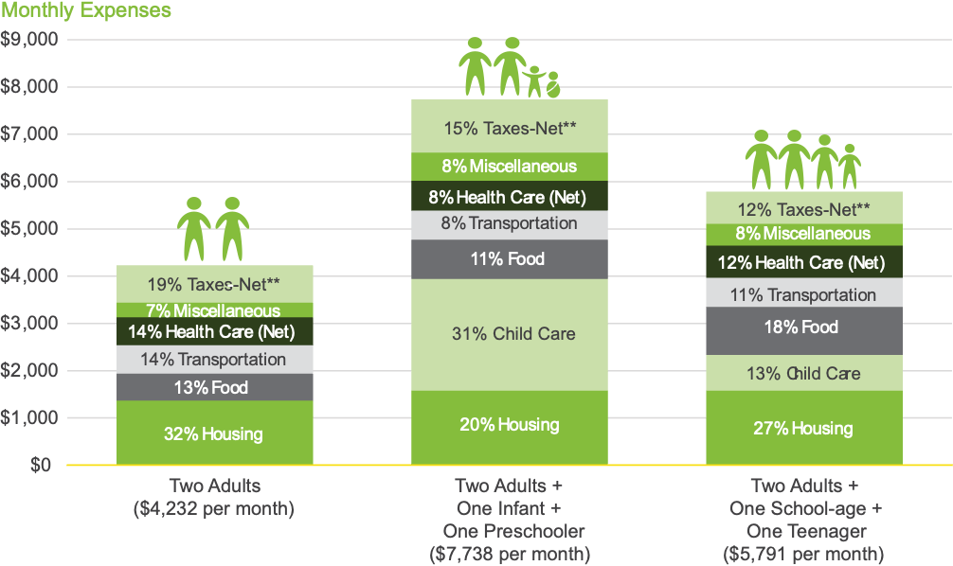
Key Findings from THE SELF-SUFFICIENCY STANDARD FOR OREGON 2021
Notes:
In Oregon, the amount needed to be economically self-sufficient varies considerably by geographic location and family composition. For instance, the amount needed to make ends meet for one adult and one preschooler varies from $19.02 per hour in Lake County to $29.35 per hour in Clackamas County, or from 231% of the federal poverty guidelines to 356% of the federal poverty guidelines for a family of two.
Percentage of Standard Needed to Meet Basic Needs for Three Family Types* Clackamas County, OR 2021: As a family grows and changes composition, the amounts they spend on basic expenses (such as food and shelter) change, and new costs are added, most notably child care. When there are just two adults, they need to earn a total of $4,232 per month to make ends meet, plus a small monthly amount of savings for emergencies. When a family expands to include two young children (one infant and one preschooler), the total budget increases to $7,738 per month. The third bar in Figure B shows the shift in the budget as the children get older, and are now a school-age child and a teenager, and no longer need as much child care. The total cost of basic needs drops to $5,791 per month and without the large amount for child care, the proportions for the other budget items all increase.

Slide 8
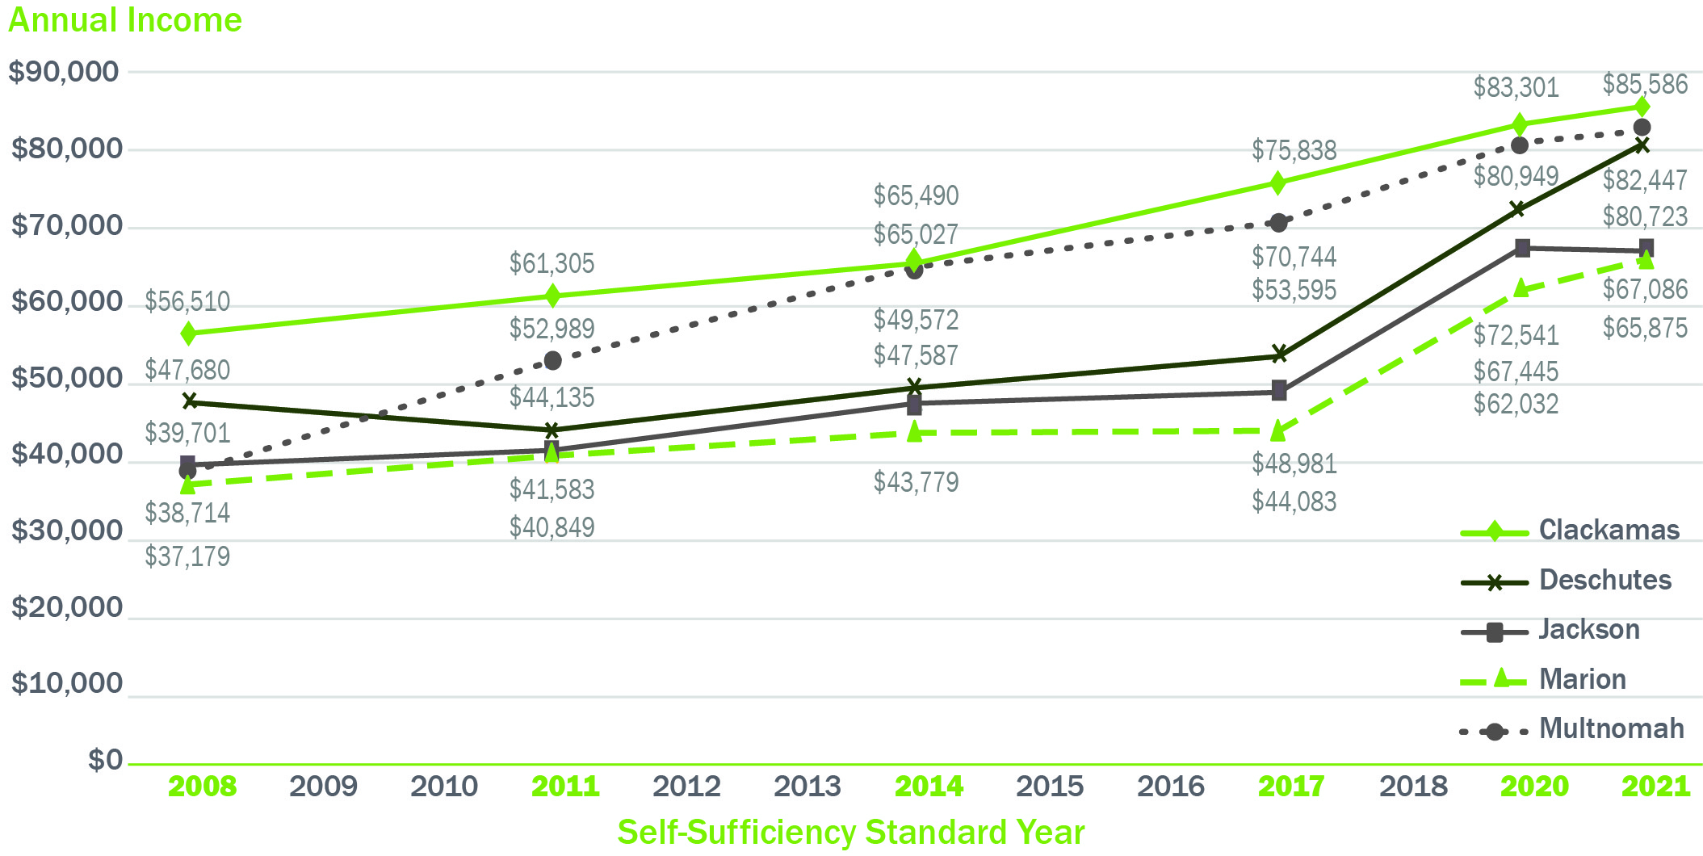
The Self-Sufficiency Standard for Oregon by Year for Select Counties
Two Adults, One Preschooler, and One School-age Child: 2008, 2011, 2014, 2017, 2020, and 2021
Notes:
For these five counties, the difference between the highest cost (Clackamas County) and lowest cost (Marion County) increased from about $19,331 in 2008 to over $31,000 in 2017 and now back to $19,711 in 2021. Marion County experienced above average child care cost increases over the last thirteen years, narrowing the difference between the higher cost Clackamas County.
While the Self-Sufficiency Standard for a four-person family of Two Adults, One Preschooler, and One School-Age Child in Washington County increased by 42% over the past twenty-one years, workers’ median earnings increased by just 28% (from $34,729 to $44,322) in Washington County and 34% statewide (from $27,389 to $36,796) over the same period. Clearly, the fact that cost increases have far outstripped wage increases puts increasing pressure on family budgets.

Slide 9
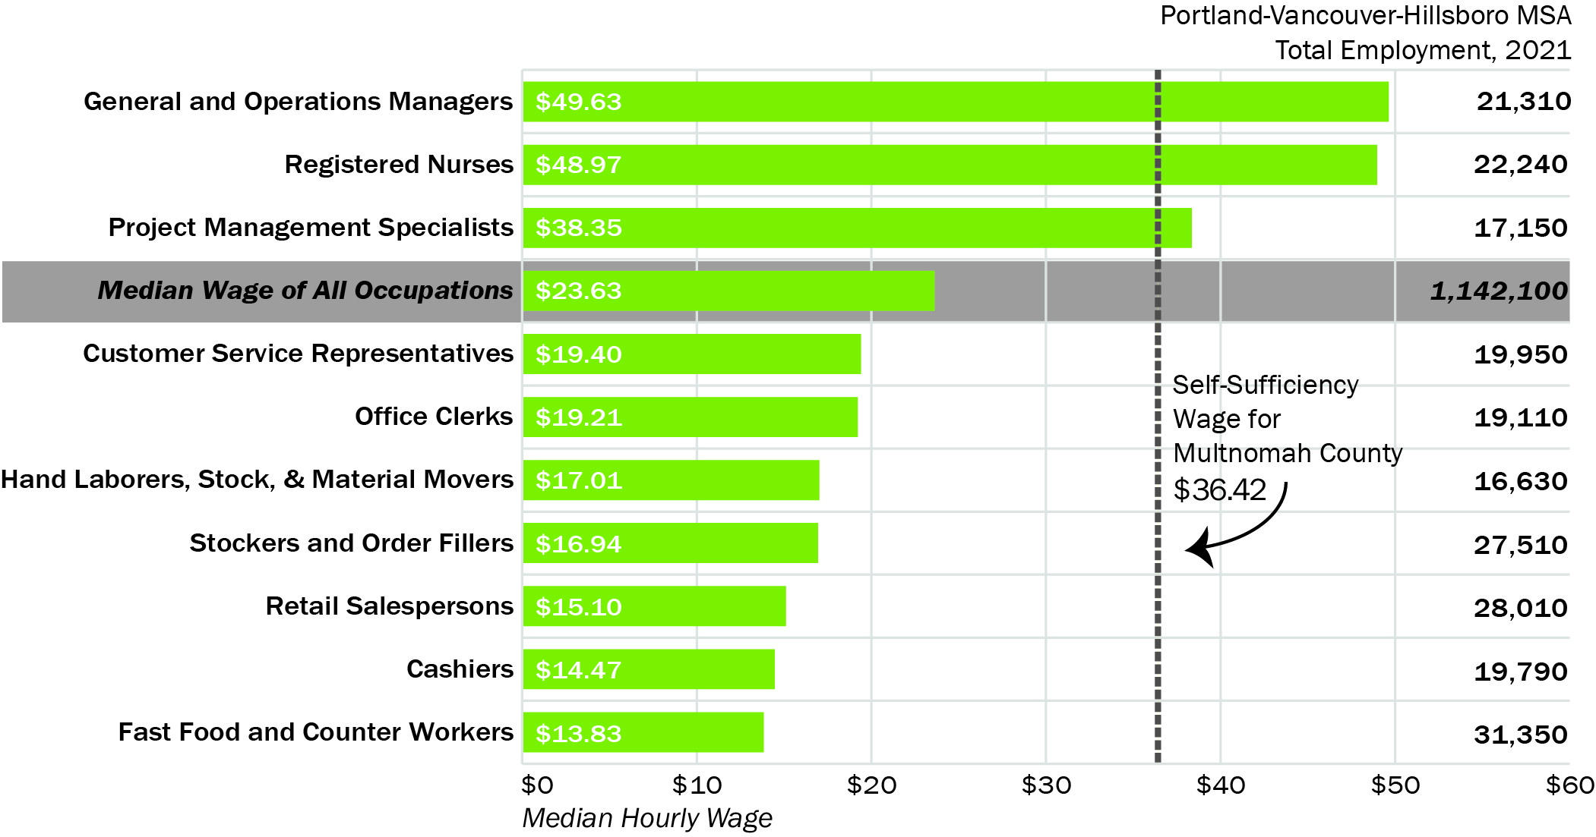
Hourly Wages of Portland-Vancouver-Hillsboro, OR-WA MSA’s Ten Largest Occupations Compared to the Self-Sufficiency Standard
One Adult, One Preschooler, & One School-age Child: Multnomah County, OR 2021
Notes:
One-fifth of the Portland-Vancouver-Hillsboro MSA’s workers are employed in the ten most common occupations,
Only three of the ten most common occupations in the Portland-Vancouver-Hillsboro MSA—general and operations managers, registered nurses and project management specialists—have a median wage that is above the Self-Sufficiency Standard for this family type in Multnomah County. On the other hand, five of this region’s top ten occupations have median earnings that are less than half of the Standard for this family type in Multnomah County: fast food and counter workers, retail salespersons, stockers and order fillers, cashiers, and hand laborers, and stock and material movers.

Slide 10
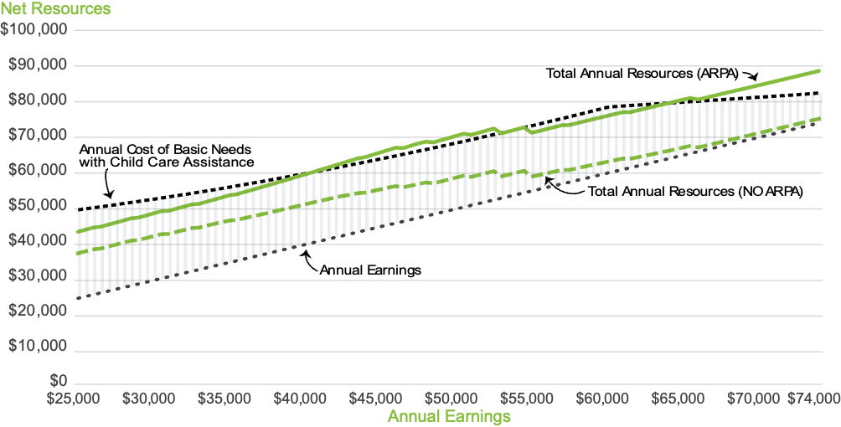
How have the American Rescue Plan Act (ARPA) Tax Credit Changes Impacted Family Budgets?
Impact of American Rescue Plan Act Tax Credit Changes on Family Budgets
One Adult, One Preschooler, & One School-age Child: Multnomah County, OR 2021
Notes:
The Standard typically includes tax credits in the calculation of hourly, monthly, and yearly budgets; however, these changes have shifted the way tax credits are reflected in the 2021 Oregon Self- Sufficiency Standard. Differing from previous years, only the refundable CTC is shown as being received monthly, as it is the only credit being delivered to families on a monthly basis. The EITC and CDCTC, along with the Oregon Working Families Household and Dependent Care Credit (WFHDC), are now shown as annual resources obtained once a year, and therefore not included in the calculation of what a family needs in order to get by at a minimal level on a monthly basis.
In order to illustrate how these tax credit adjustments impact a family’s total yearly resources, Figure K displays three financial scenarios modeling a family living in Multnomah County with a preschooler and school-age child. The horizontal axis represents yearly earnings while the vertical axis represents total net resources. While the CTC is now paid on a monthly basis, it should be noted that the EITC, CDCTC, and the WFHDC are paid to families once per year in the form of a tax refund. If the families do not file taxes or do not report child care costs, they are ineligible for these added yearly resources.
ANNUAL COST OF BASIC NEEDS WITH CHILD CAREASSISTANCE. The top dashed black line shows what a family of one adult, one preschooler, and one school-age child needs in order to get by at a minimal level. This line visualizes the sum of the family’s basic expenses and taxes without tax credits. As an example, with yearly earnings of $45,000, the parent still only earns 70% of what they need to cover basic expenses,
TOTAL ANNUAL RESOURCES WITHOUT ARPA. Tax credits can have an impactful effect on family wage adequacy. Even prior to the ARPA tax credit changes, tax credits increase a family’s yearly resources to help cover basic needs. The green dashed line visualizes the yearly resources this family receives based on their yearly earnings before ARPA was enacted. For example, for the parent who earns $45,000 a year, the family was eligible for $10,468 in yearly tax credits. Despite the added resources, the family still cannot meet all basic needs,
TOTAL ANNUAL RESOURCES WITH ARPA. The green line in Figure K represents total resources and earnings for this family in Multnomah County after the passage of ARPA and the additional amount of refundable tax credits. With the increased tax refund of $20,807, the family who earned $45,000 now has $65,807 in total yearly resources, allowing them to cover all of their basic needs.

Slide 11
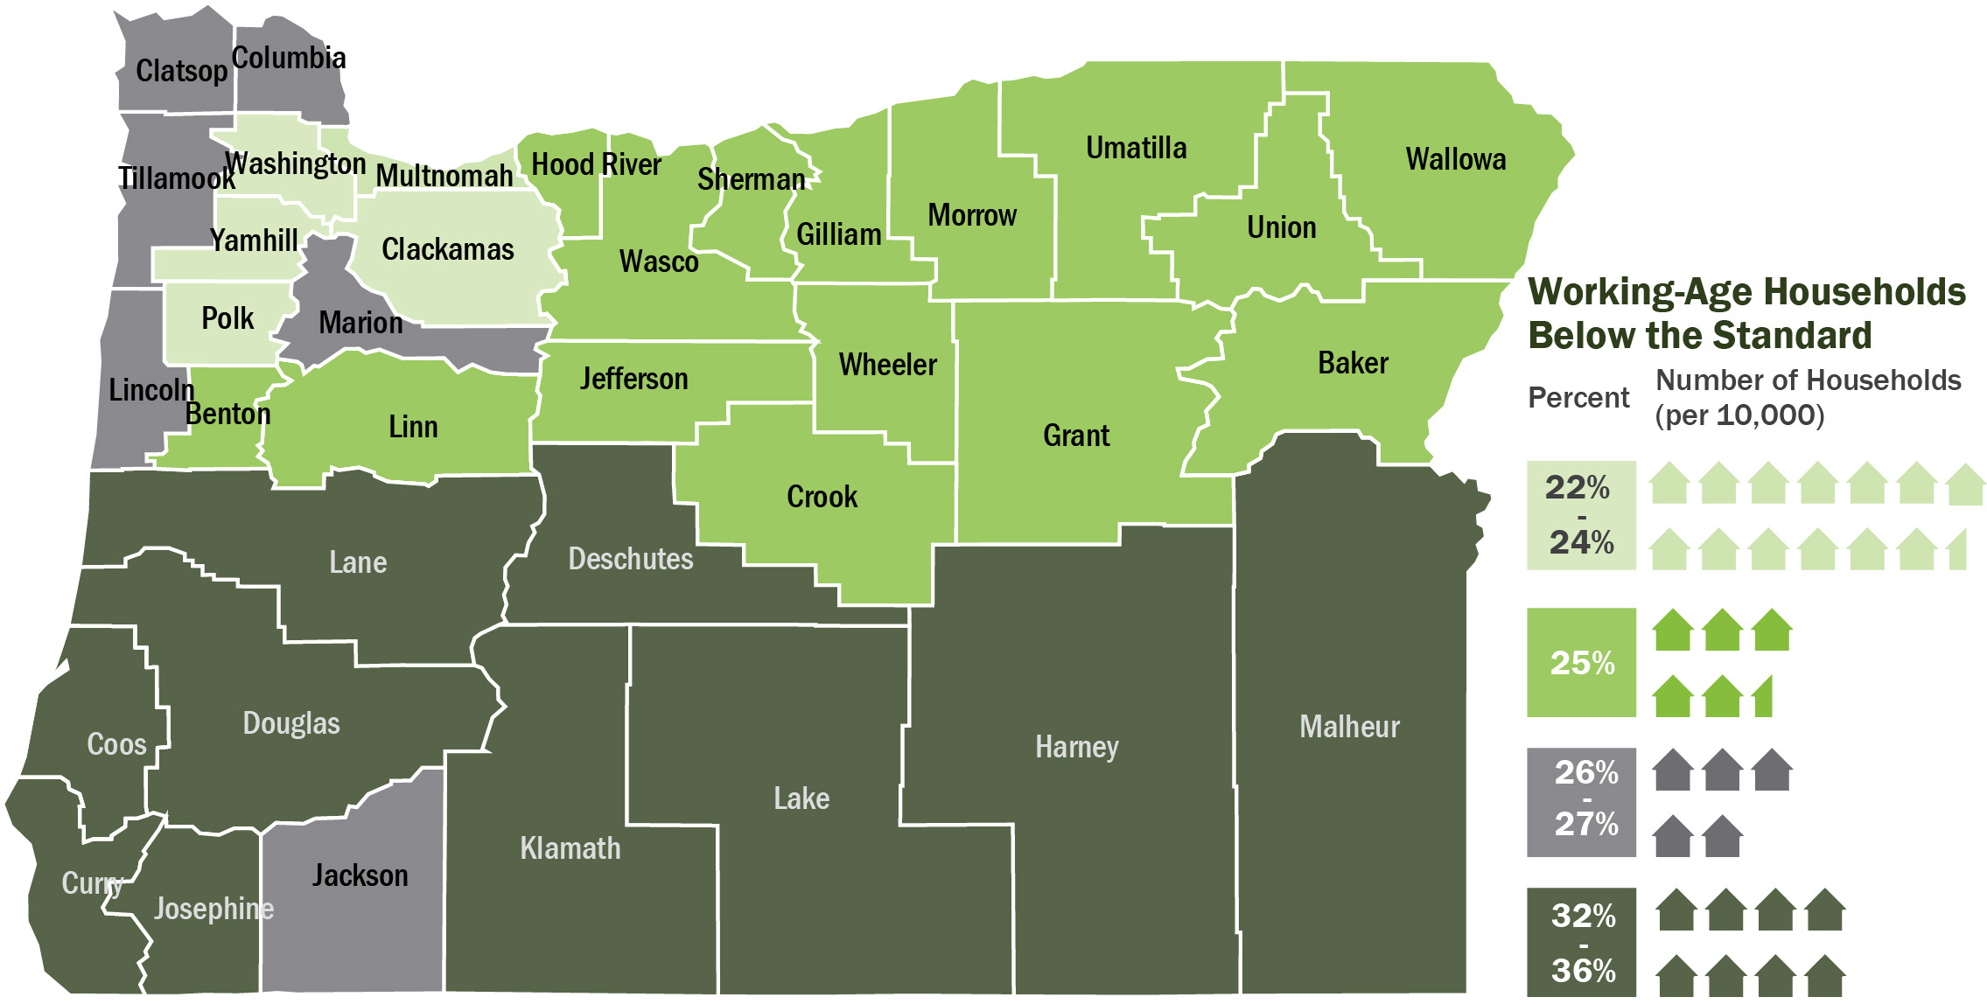
Key Findings from Overlooked & Undercounted
Struggling to Make Ends Meet in Oregon
Notes:
STEP 1: Calculate the Self-Sufficiency Standard
STEP 2: Create a Dataset of Oregon Households
To estimate the number of households below the Self-Sufficiency Standard for Oregon, this study uses the 2019 American Community Survey (ACS) 1-year Public Use Microdata Sample (PUMS) by the U.S. Census Bureau. The ACS is an annual survey of the social, housing, and economic characteristics of the population.
STEP 3: Compare Household Income to Income Benchmark
The Self-Sufficiency Standard for Oregon is used to determine if a household has adequate income to cover each household members’ basic needs. Earnings for each household member are summed up and adjusted to 2019 dollars to determine total household income. Total household income is then compared to the calculated Standard for the appropriate family composition and geographic location. Regardless of house-hold composition, it is assumed that all members of the household share income and expenses. Household income is also compared to the U.S. Census Bureau’s poverty threshold to calculate whether households are above or below poverty.
Altogether there are more than 292,544 Oregon households struggling to make ends meet—living throughout every Oregon county. Lane County has the highest rate of income inadequacy amongst all Oregon counties with over one third (36%) of households having incomes that are not sufficiently meeting their basic needs (Figure A). Indeed, with the exception of Jackson County, a third of households in all counties across the southern half of the state lack enough income to meet their basic needs according to the Standard.

Slide 12
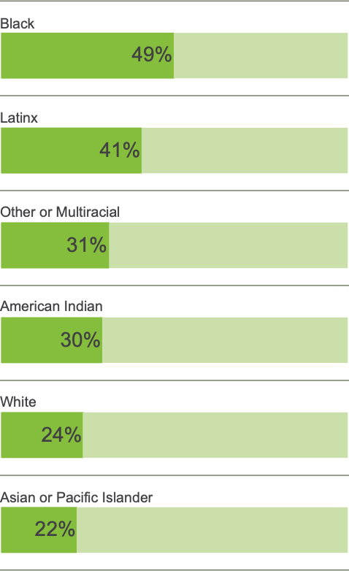
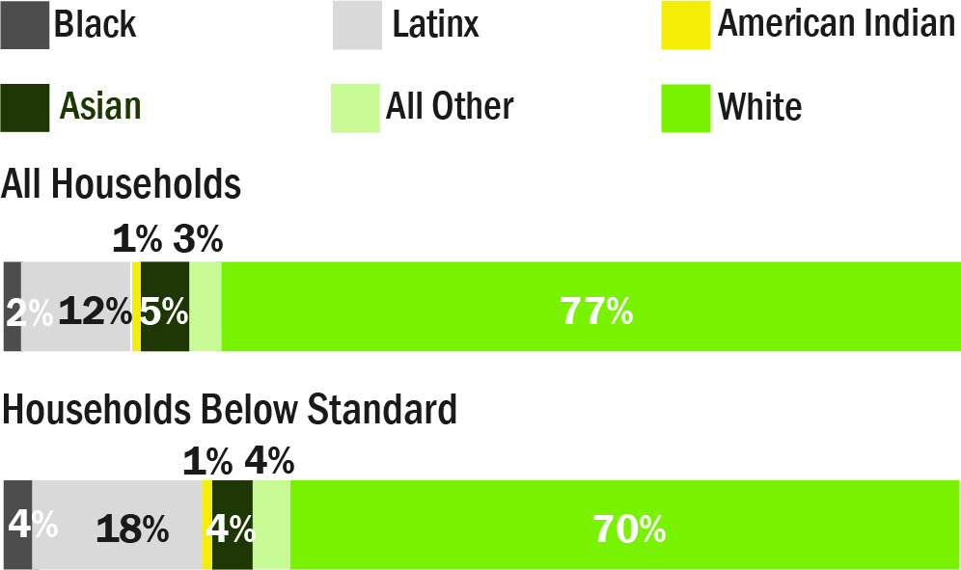
Income Inadequacy Rate by Race/
Ethnicity of Householder*: OR 2019
*The householder is the person (or one of the persons) in whose name the housing unit is owned or rented or, if there is no such person, any adult member, excluding roomers, boarders, or paid employees.
Notes: Latinx refers to Hispanic/Latino ethnicity, regardless of race. Therefore all other racial/ethnic groups are non-Hispanic/Latino. See sidebar for more details on race/ethnicity definitions.
Source: U.S. Census Bureau, 2019 ACS 1-Year Public Use Microdata Sample.
Notes:
While inadequate income is an issue facing all racial/ethnic groups, people of color disproportionately experience income inadequacy.14
As illustrated by Figure D, Black, Latinx, American Indian, and multiracial householders experience the highest rates of income inadequacy in Oregon.
Black-headed households have the highest income inadequacy rate of all racial/ethnic groups in Oregon—49% of Black households lack sufficient income. Meaning that almost half of all Black households have incomes that do not support their basic needs. This is double the income inadequacy rate of White households (24%).
Among Latinx-headed households, regardless of race, 41% struggle to meet their basic needs.

Slide 13
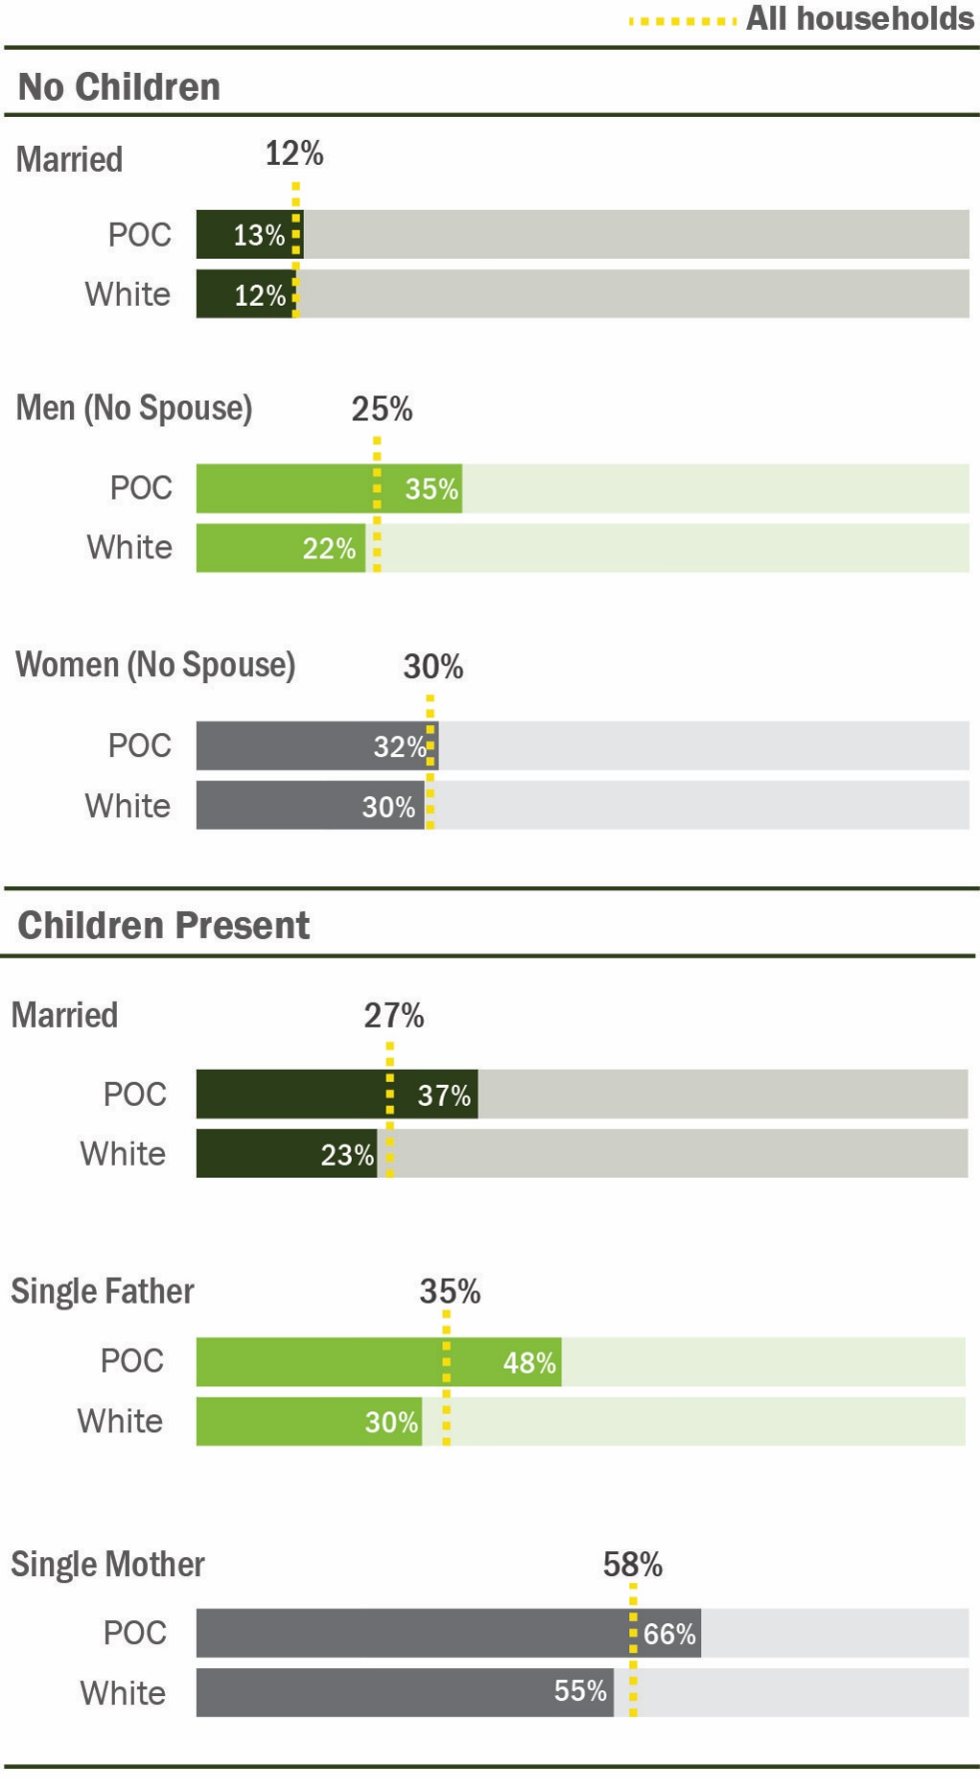
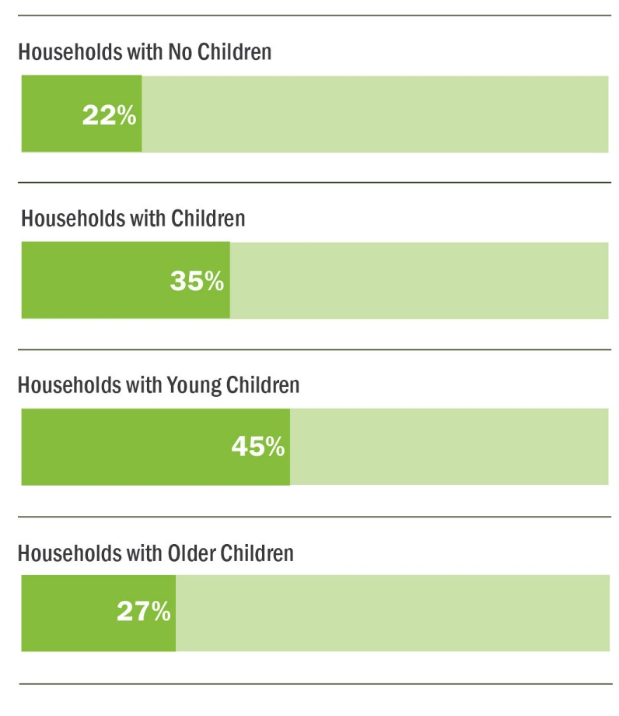
Income Inadequacy Rate by Presence of Children: OR 2019
Source: U.S. Census Bureau, 2019 ACS 1-Year Public Use Microdata Sample.
Notes:
Compared to households without children, the rate of income inadequacy for households with children increases from 22% to 35% (Figure H). Moreover, as highlighted by The Self-Sufficiency Standard for Oregon 2021, the presence of children, particularly young children, has a large impact on household budgets. Reflecting the need for full-time child care, households with at least one child under the age of five have a higher rate of income inadequacy than households with only school-age children or teenagers (45% compared to 27%). As a result, while households with children only account for 37% of all households in Oregon, 49% of households with incomes below the Standard have children present (see Figure I).
Altogether, parents, particularly single mothers experience higher levels of income inadequacy than non-parents. The very high rates of income inadequacy for single mothers compared to single fathers suggests that a combination of gender and the presence of children—being a woman with children—but especially gender, is associated with the highest rates of income inadequacy. The causes of these high levels of income inadequacy are many, including pay inequity and gender-based discrimination, as well as the expenses associated with children, particularly child care.

Slide 14
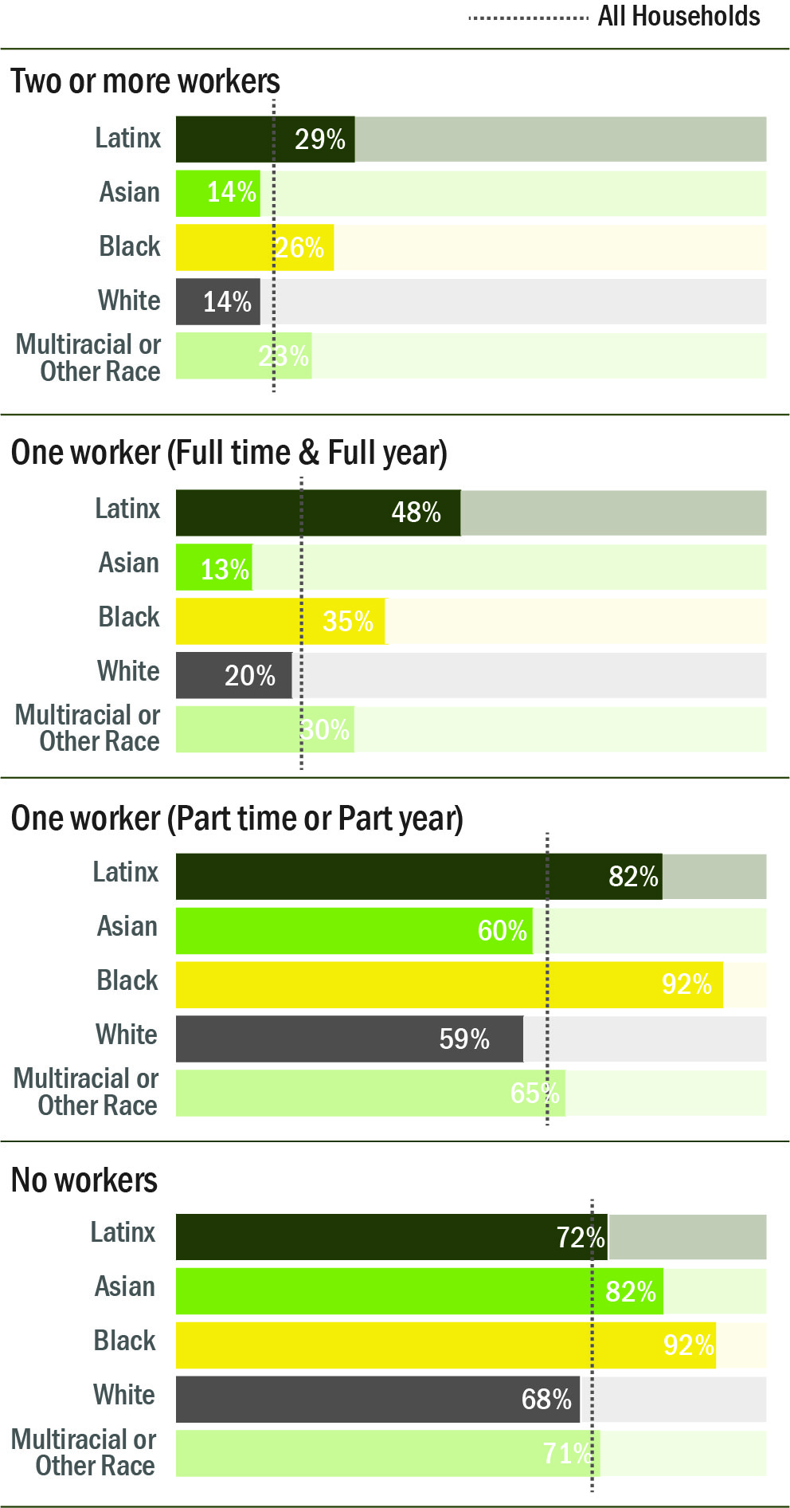
Income Inadequacy Rate by Workers* & Race/Ethnicity of Householder**: OR 2019
Source: U.S. Census Bureau, 2019 ACS 1-Year Public Use Microdata Sample.
Notes:
While more hours of work per household reduces income inadequacy, some BIPOC, particularly Black and Latinx communities, must work more to achieve the same levels of self-sufficiency as White workers. For each level of work effort (number of workers and hours worked), income inadequacy rates range from around 18 to 36 percentage points higher for people of color (see Figure R). For example, in households with one full-time worker, one fifth (20%) of White households, but almost half (48%) of Latinx households lack adequate income.

Slide 15
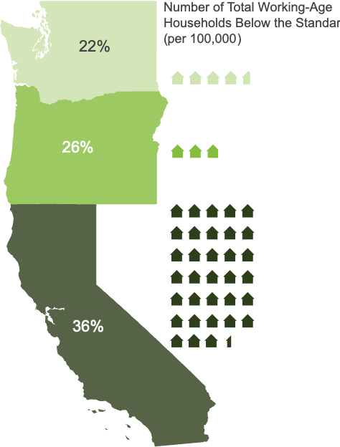
Households Struggle Across the West Coast
Regional Comparison of Percentage of
Households Below Standard in 2019: WA, OR, CA
Source: U.S. Census Bureau, 2019 ACS 1-Year Public Use Microdata Sample.
Notes:
As the official poverty measure is the same across the United States, official poverty rates fail to account for difference in cost of living by and within states. For example, in all three West Coast states a two-bedroom rental in the least expensive counties was around $700 per month in 2019 according to the Self-Sufficiency Standard. However, a basic two-bedroom rental in 2019 was $1,442 per month in Portland, $2,369 in Seattle, and $3,137 in San Francisco. Despite very different costs of living, the poverty rate in Oregon and California are both around 9% while Washington is slightly lower at about 7%.

Slide 16
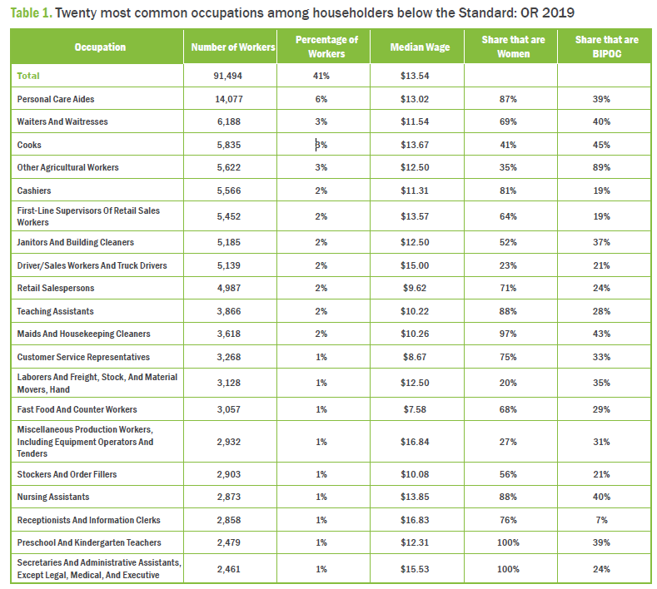
Occupations and COVID-19
Source: U.S. Census Bureau, 2019 ACS 1-Year Public Use Microdata Sample.
Notes:
With the COVID-19 pandemic, this trend has exacerbated the economic and health risk facing low-wage workers. Low-wage workers are disproportionately in service occupations that were at higher risk for loss of income during the pandemic. Those who stayed employed, working in essential businesses, have done so while facing increased health risks.
Women and people of color with inadequate income are even more likely to be concentrated in fewer occupations: 49% of all households headed by women and 48% of all households headed by people of color with inadequate income are working in just 20 occupation groups. Intersecting race and gender, the top 20 most common occupations for women of color householders account for 62% of all employment for women of color householders below the Standard, indicating that women of color are concentrated in even fewer occupations.
Additionally, during the pandemic, the lack of affordable and available childcare reduced the number of people in the labor force. Nationally, nearly 3 million women left the labor force in 2020. In spring 2020, the labor force participation rate for women was at a thirty-year low

Slide 17
The Self-Sufficiency Standard is More than Data – it is a Tool
Used by customers of workforce, training, and education programs seeking paths to self-sufficiency
Used by managers to evaluate program effectiveness
Used by communities and businesses as an indicator of the basic cost of living
Used by policymakers to create programs and pathways that lead to economic self-sufficiency for working families
Notes:
Using the Self-Sufficiency Standard, this report finds that the problem of inadequate income is extensive, affecting families throughout Oregon before the pandemic, in every racial/ethnic group; among men, women, and children; and in all counties. Households with inadequate incomes are part of the mainstream workforce, yet despite working long hours, they are not recognized as having inadequate income by the federal poverty level. This report is meant to provide a contribution to promoting economic self-sufficiency by identifying the extent and nature of the causes of income inadequacy.

Slide 18

Questions?
Email akuckl@uw.edu,
And/or visit the www.selfsufficiencystandard.org/oregon to see the full reports.

